Slide 1

Geospatial tools available on SCINet
SCINet Office
ARS Geospatial Environmental Epidemiology Research Unit Planning Workshop
May 21-22, 2024

Slide 2
Overview
Computing resources
Interfaces and software
Training and education resources

Slide 3

Computing resources
SCINet: A cutting-edge research environment that provides scientific computing resources for all of ARS.

Slide 4
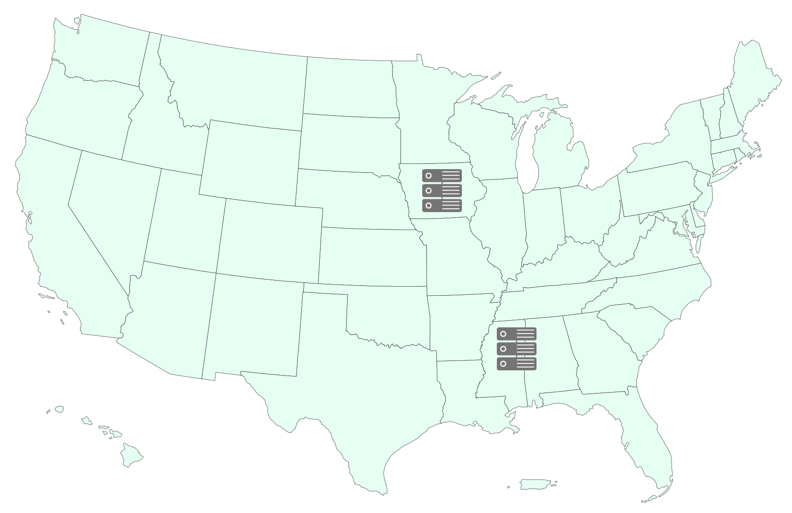


Computing resources
Large-scale computing
Notes:
SCINet clusters: Ceres in Iowa and Atlas in Miss.

Slide 5
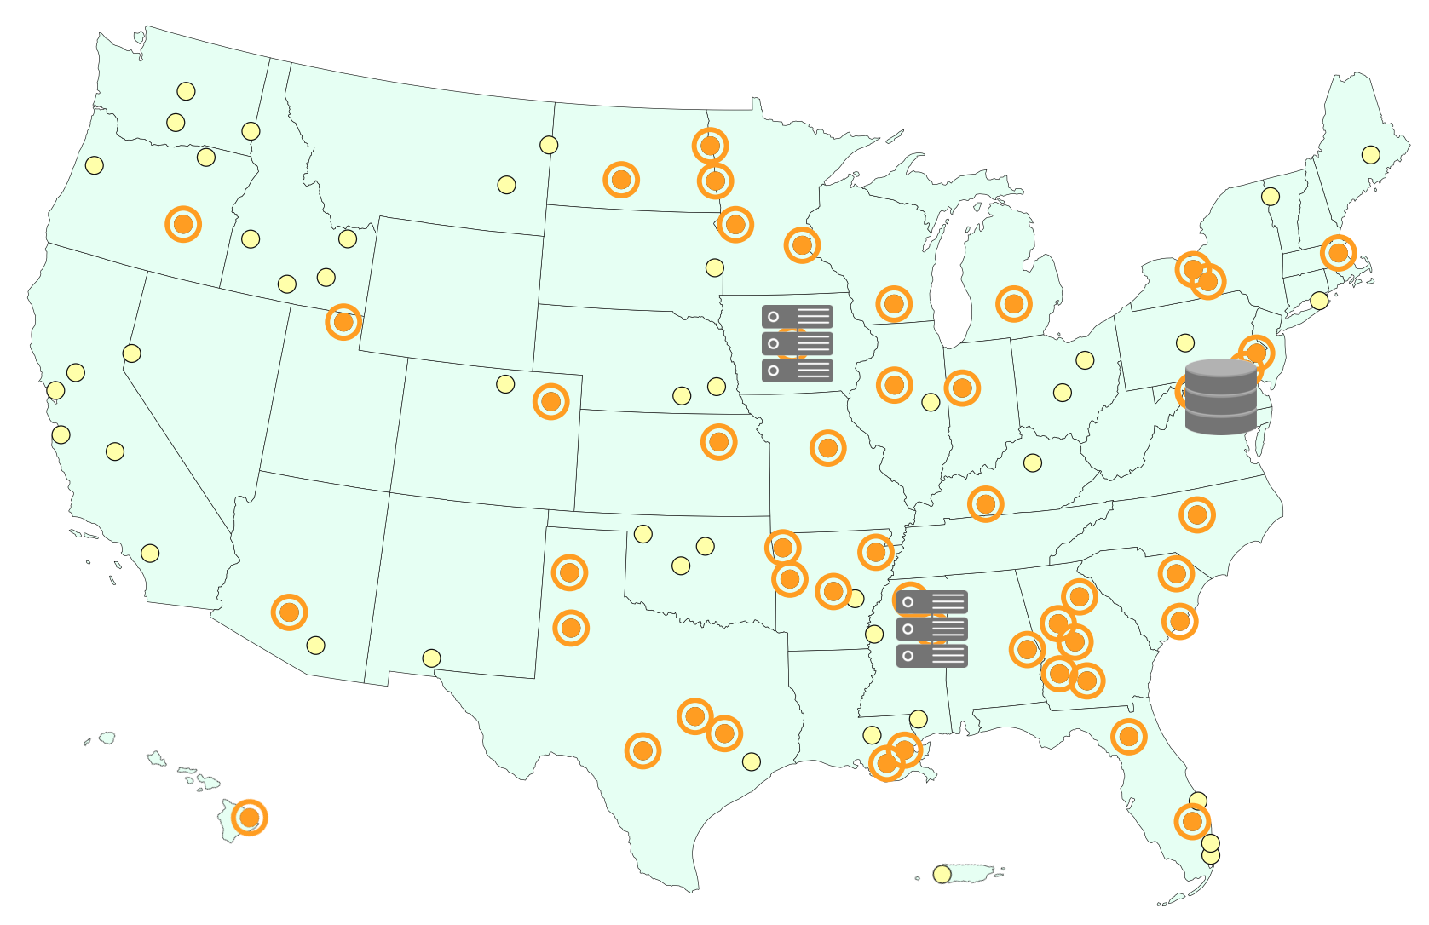
Computing resources
Large-scale computing
High-speed data transfer
Notes:
Also infrastructure to provide high-speed data transfer capabilities to SCINet from ARS locations. Current supported locations, including Starkville, are marked in orange. This is handy when needing to transfer large datasets.

Slide 6
Overview
Computing resources
Interfaces and software

Slide 7
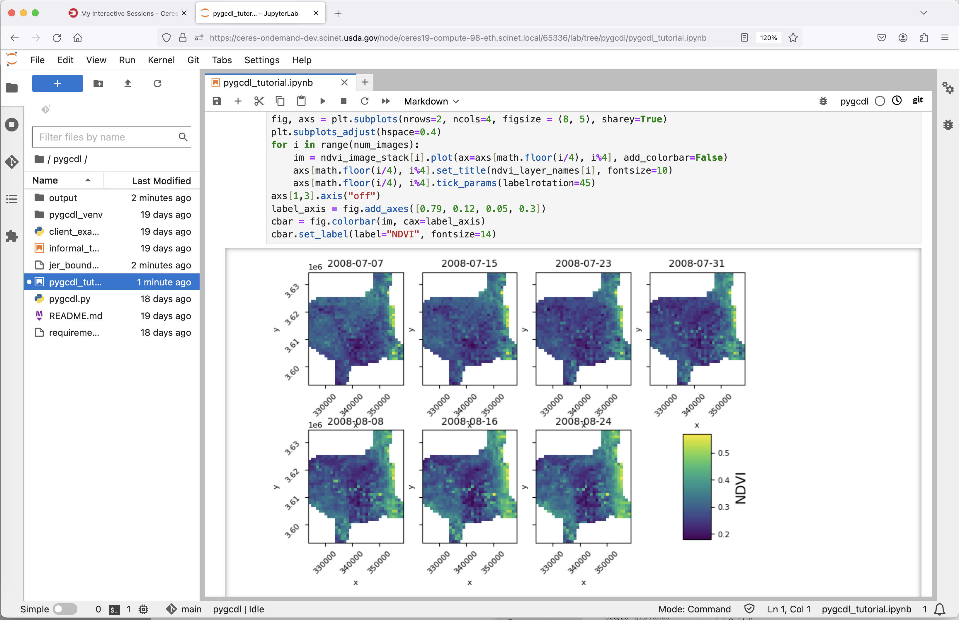
Notes:
In addition to traditional command line options, multiple GUI options helpful in geospatial analyses and visualization are on the web-based Open OnDemand interface, including JupyterLab for Python

Slide 8
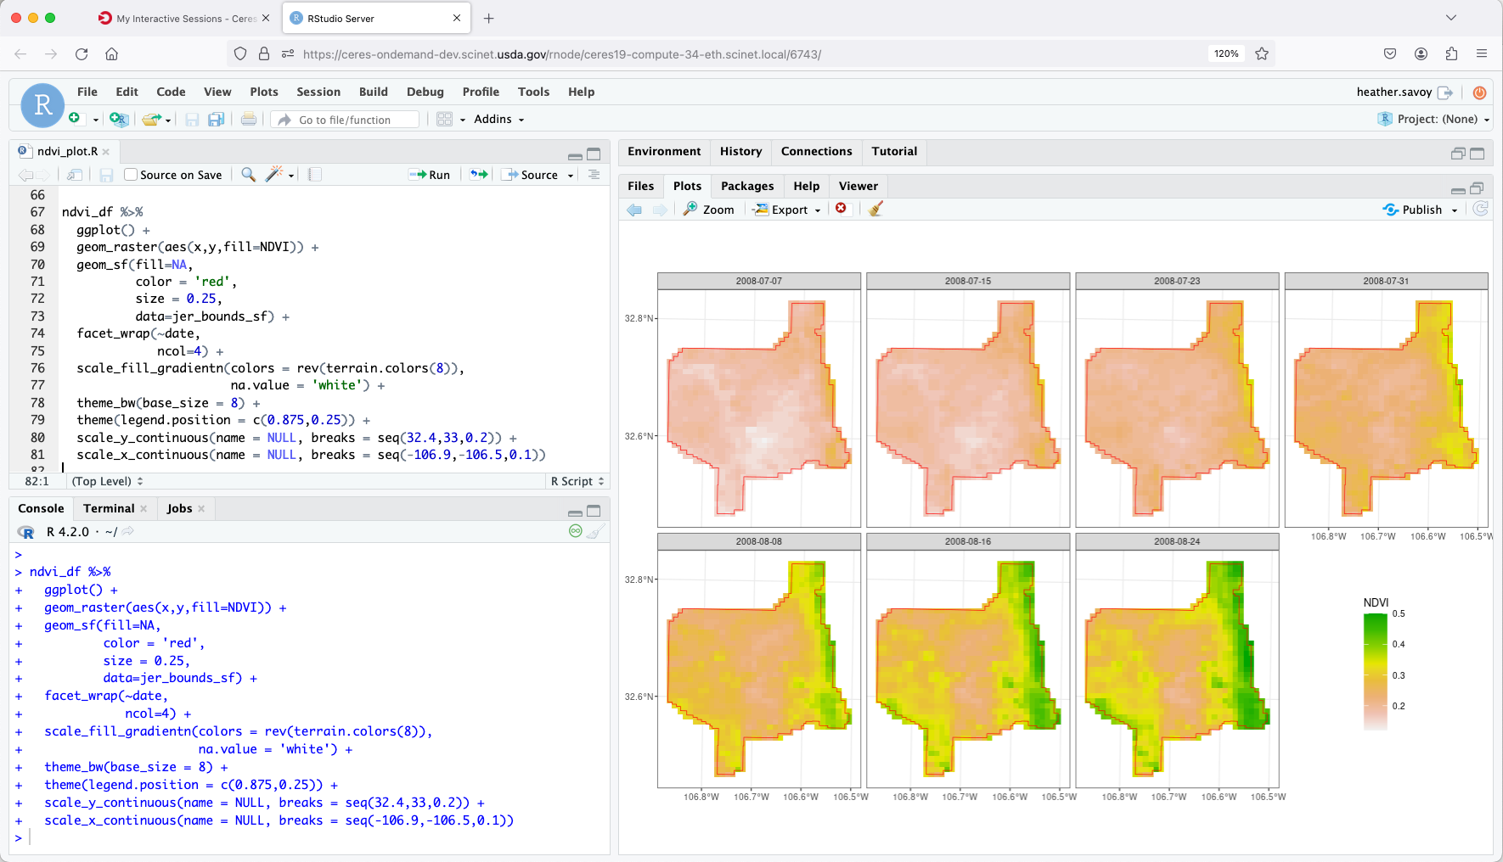
Notes:
RStudio for R

Slide 9
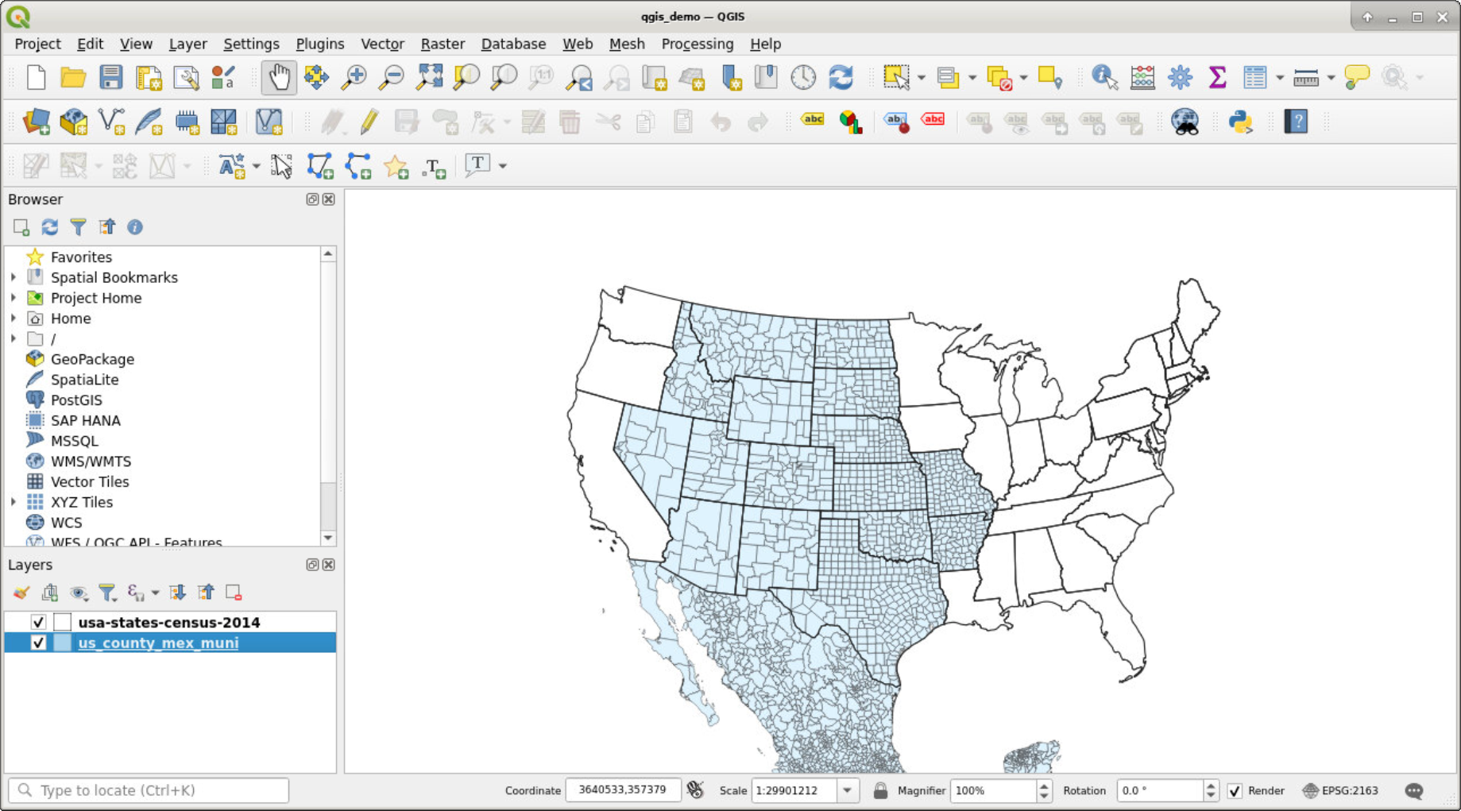
Notes:
QGIS, an open-source GIS application

Slide 10
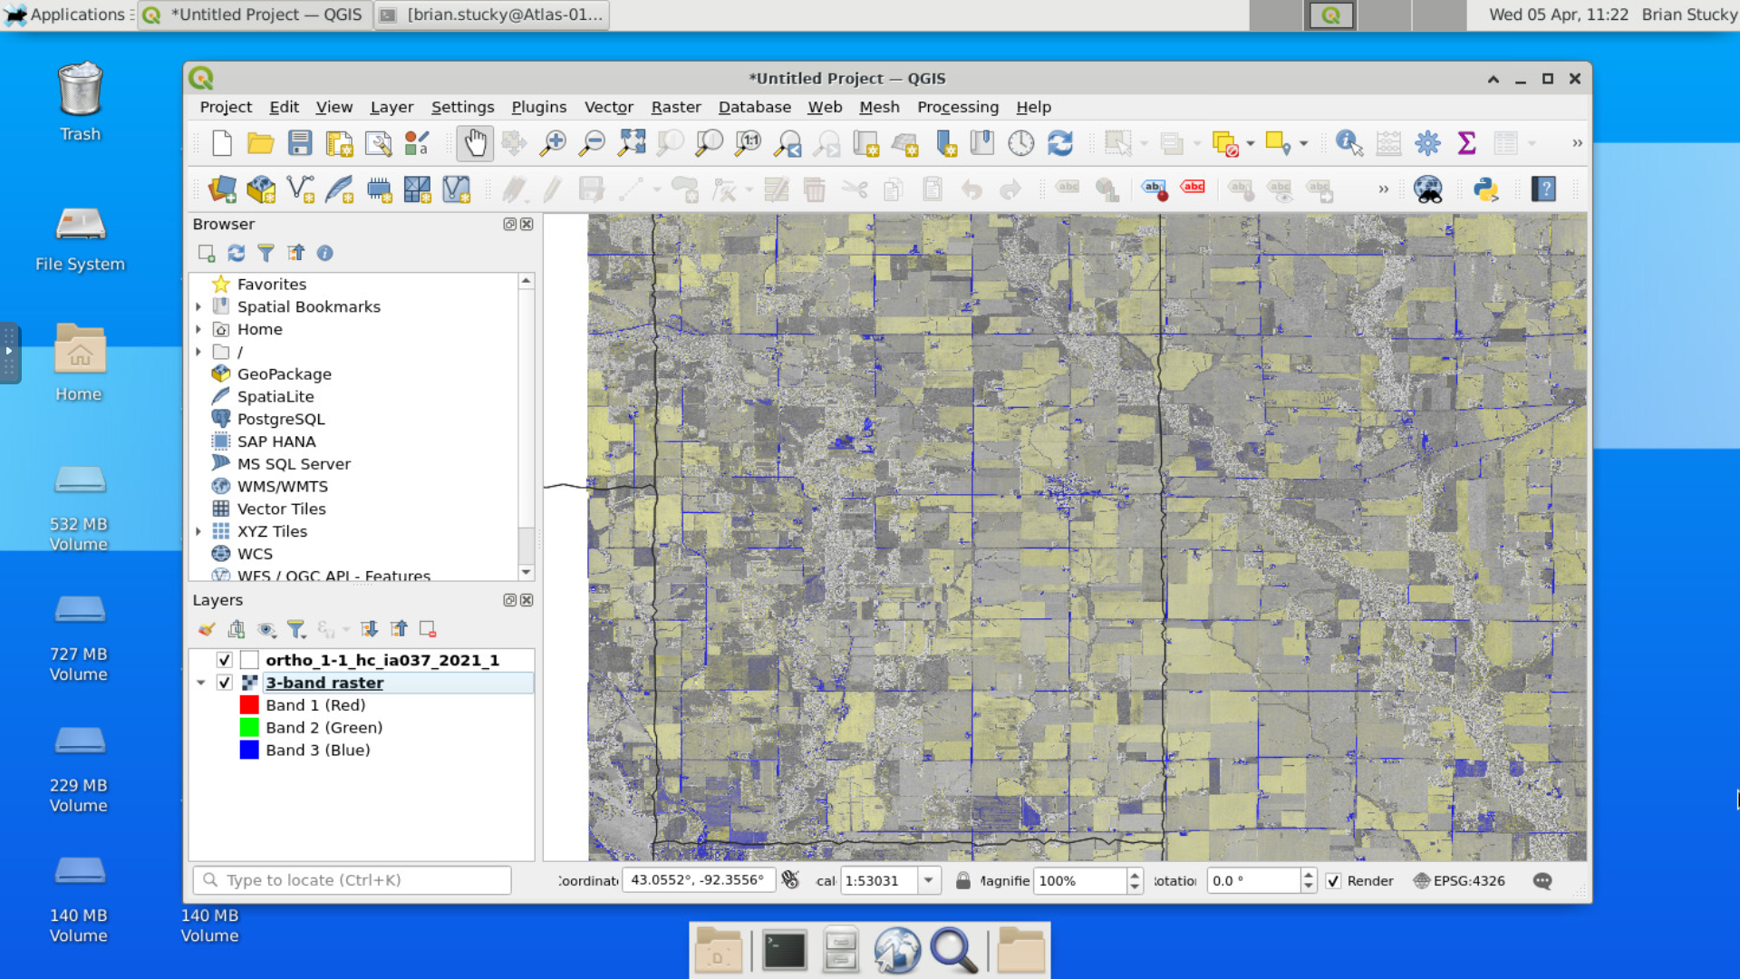
Notes:
A full desktop is also an option if that is preferred, e.g., showing running QGIS in a desktop

Slide 11









ENVI
Notes:
Many common geospatial software packages, some represented here, are available or easily supported on SCINet as GUI or command line options

Slide 12
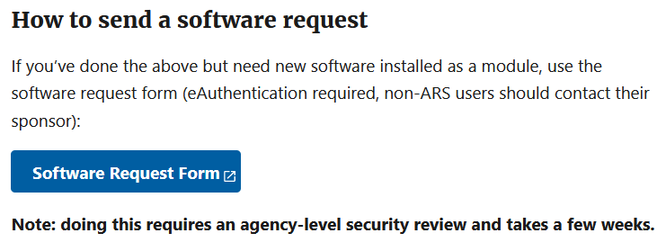
Interfaces and software
What if the software I need is missing?
You can install R and Python packages yourself (e.g., using install.packages() [R] or pip or conda [Python]).
Open-source software can often be “installed” and run from your project directory on a cluster.
System-wide software installs can be requested via the SCINet website.

Slide 13
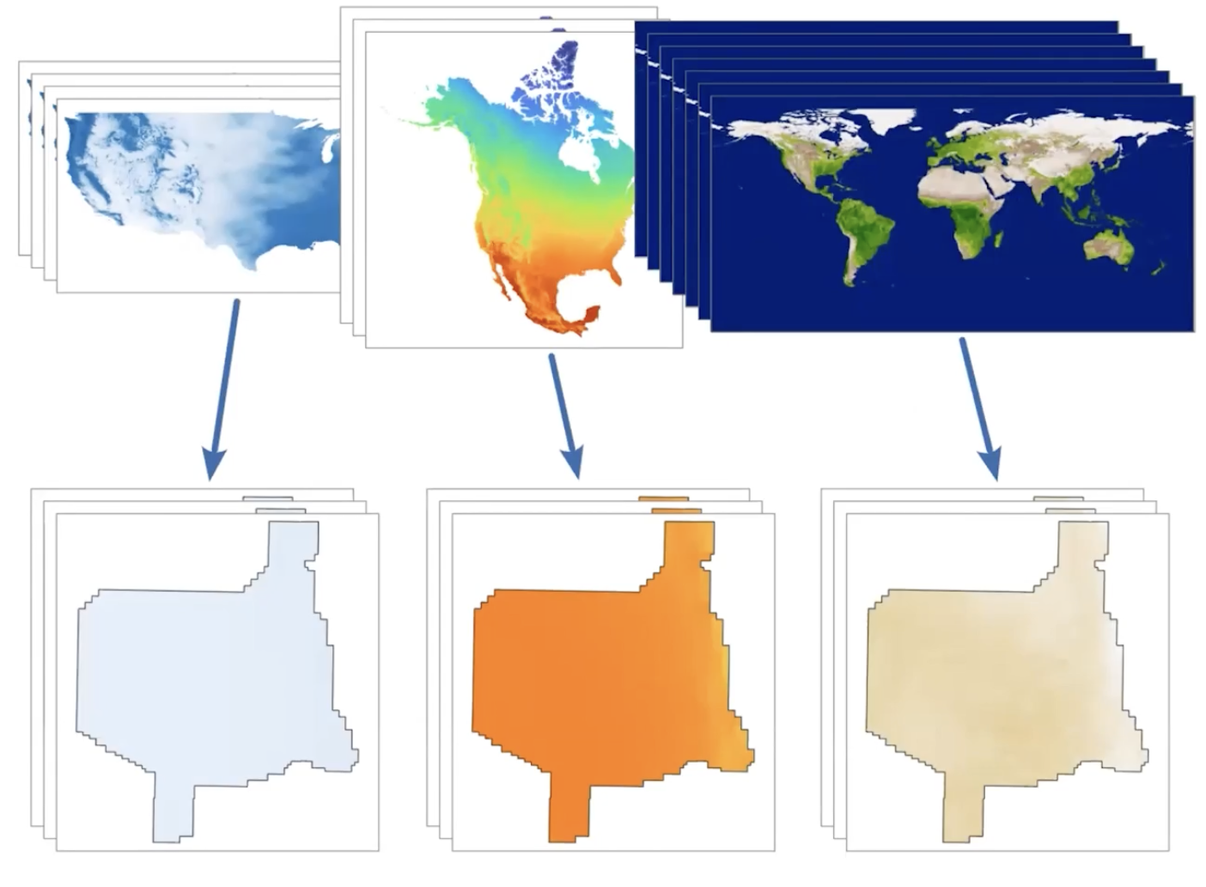
GeoCDL
Geospatial Common Data Library
Several commonly used raster datasets are stored on SCINet resources.
API to extract and harmonize spatiotemporal subsets from multiple datasets.
R and Python packages available and in development.
Notes:
A SCINet community-driven project to reduce the amount of space consumed on clusters by large, commonly used geospatial raster datasets. Also reduce time spent on downloading, subsetting, and reprojecting raster datasets from disparate sources.
On Ceres for now, intended to be on Atlas too

Slide 14
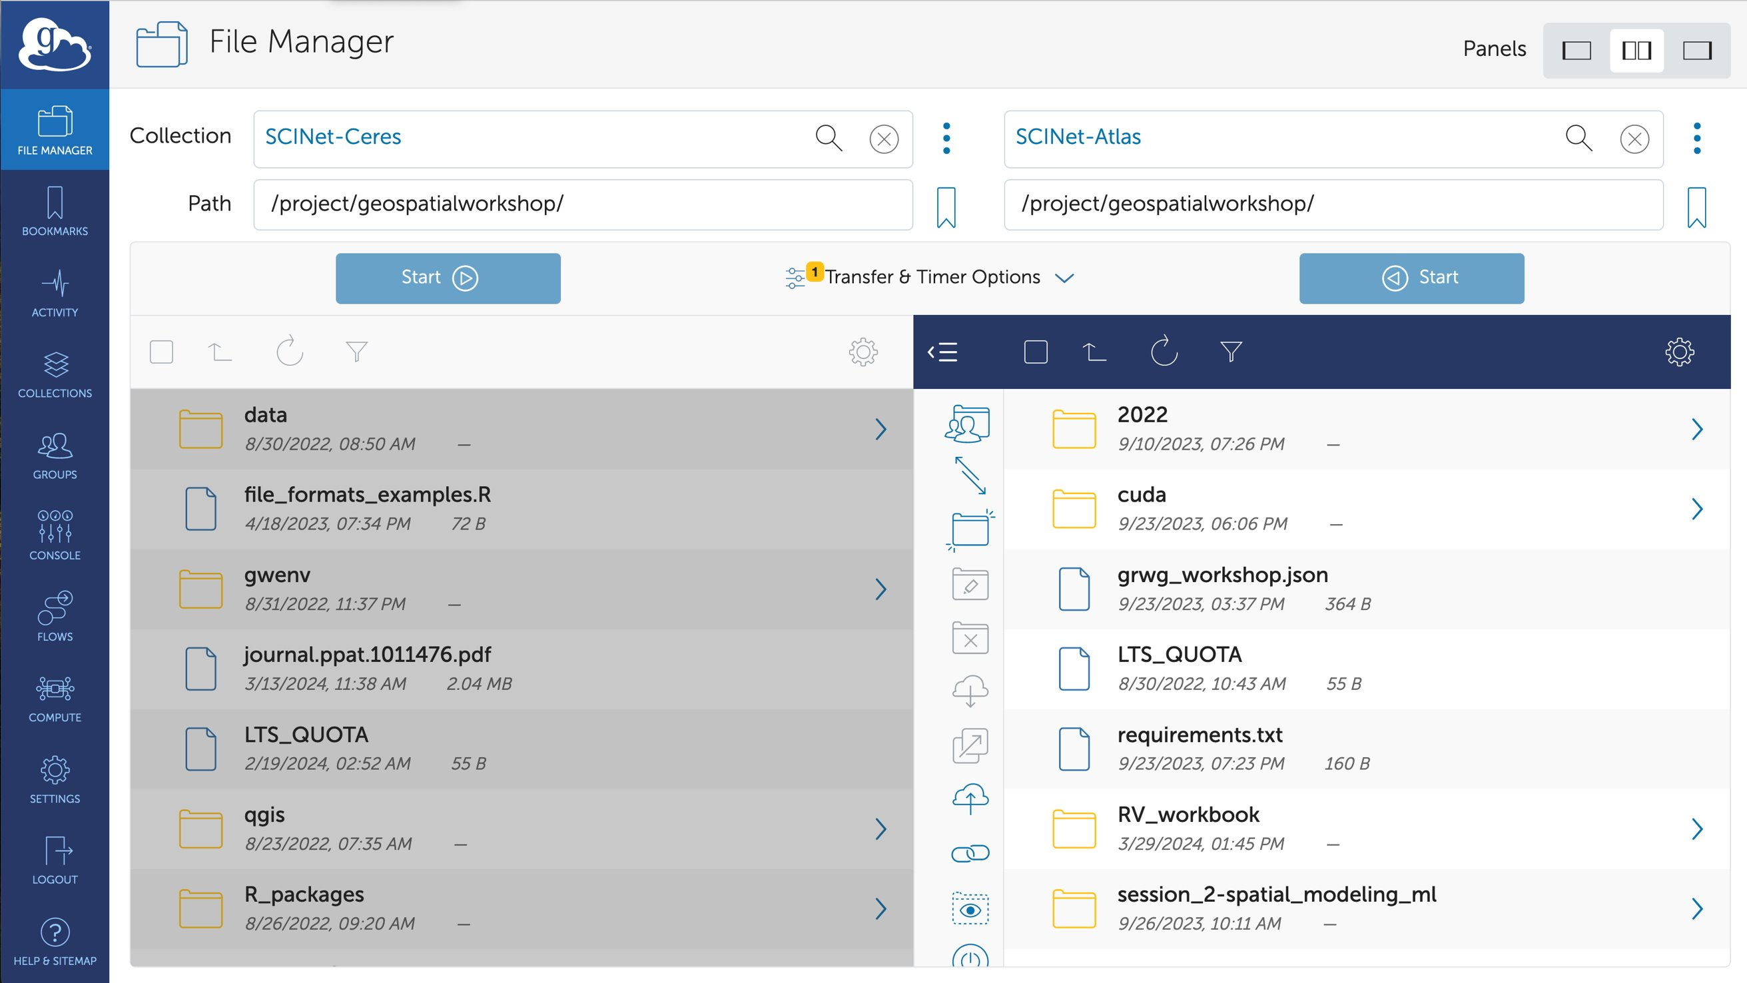
Notes:
If there are large and/or many datasets, you can transfer files to and among our clusters and longterm storage via Globus.

Slide 15
Overview
Computing resources
Interfaces and software
Training and education resources

Slide 16
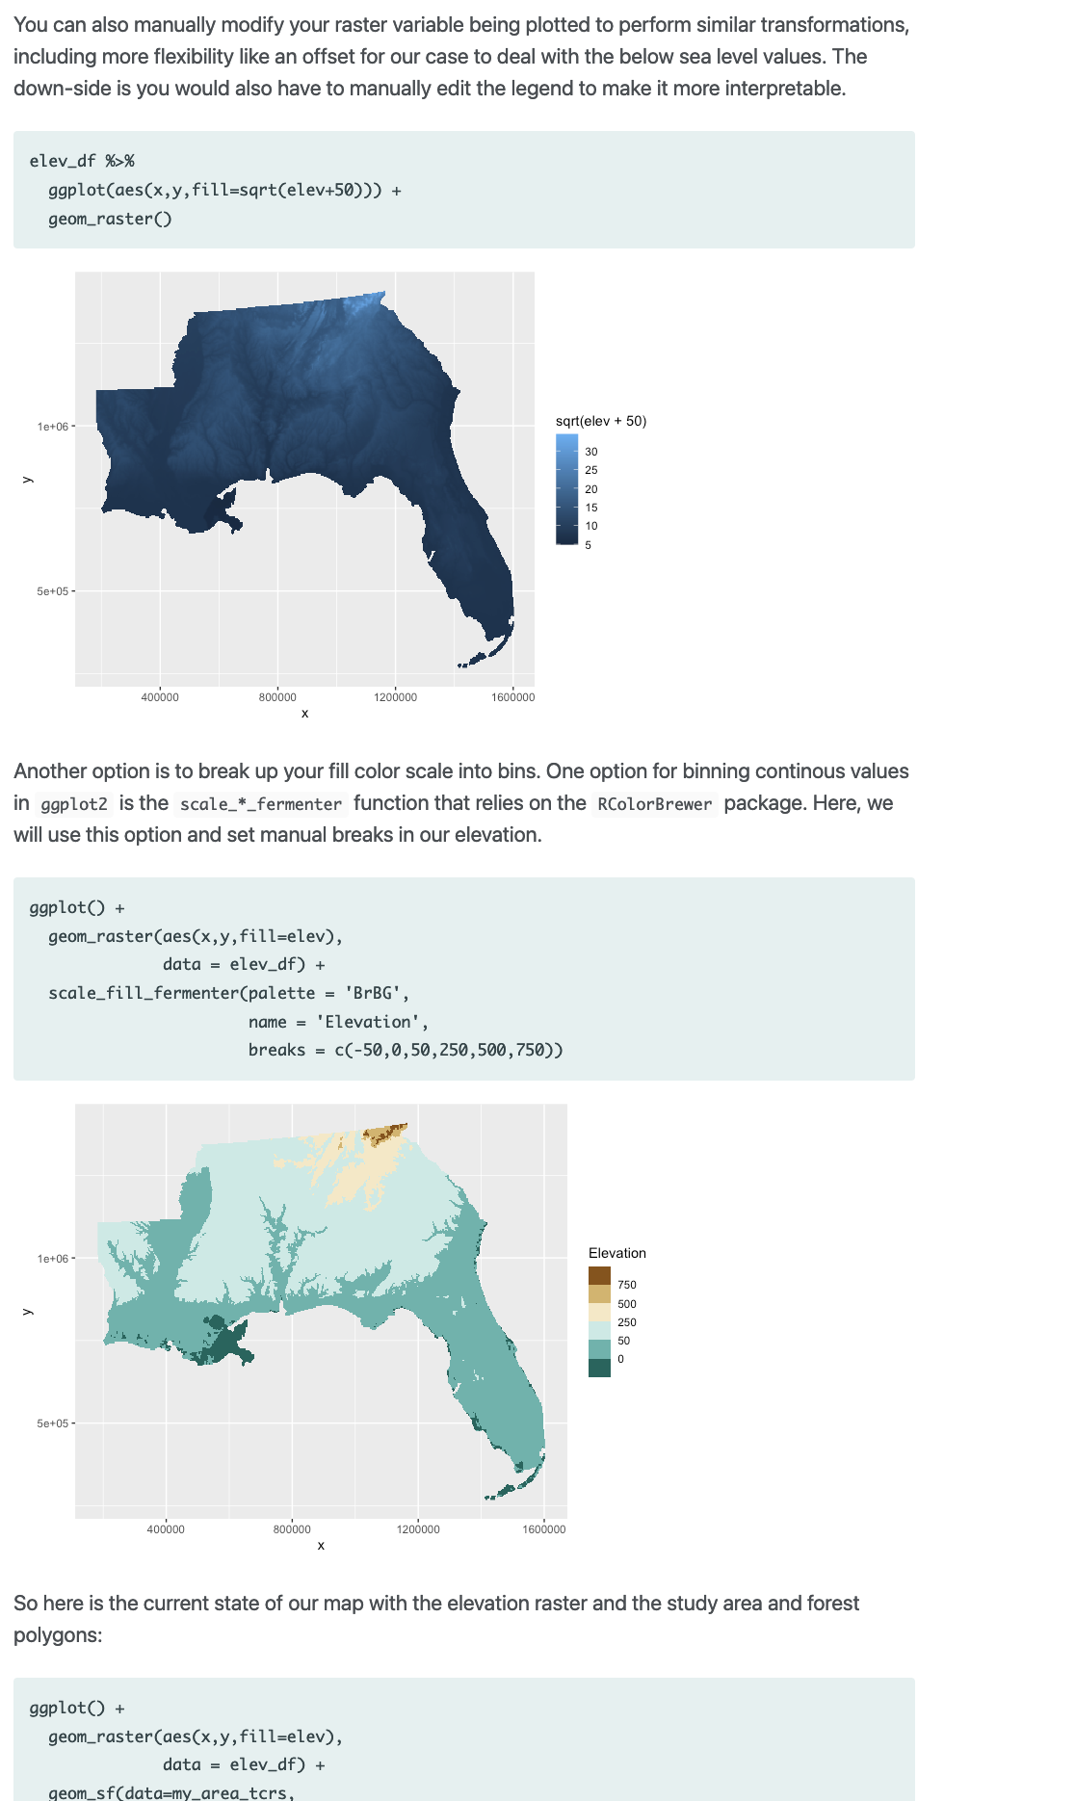
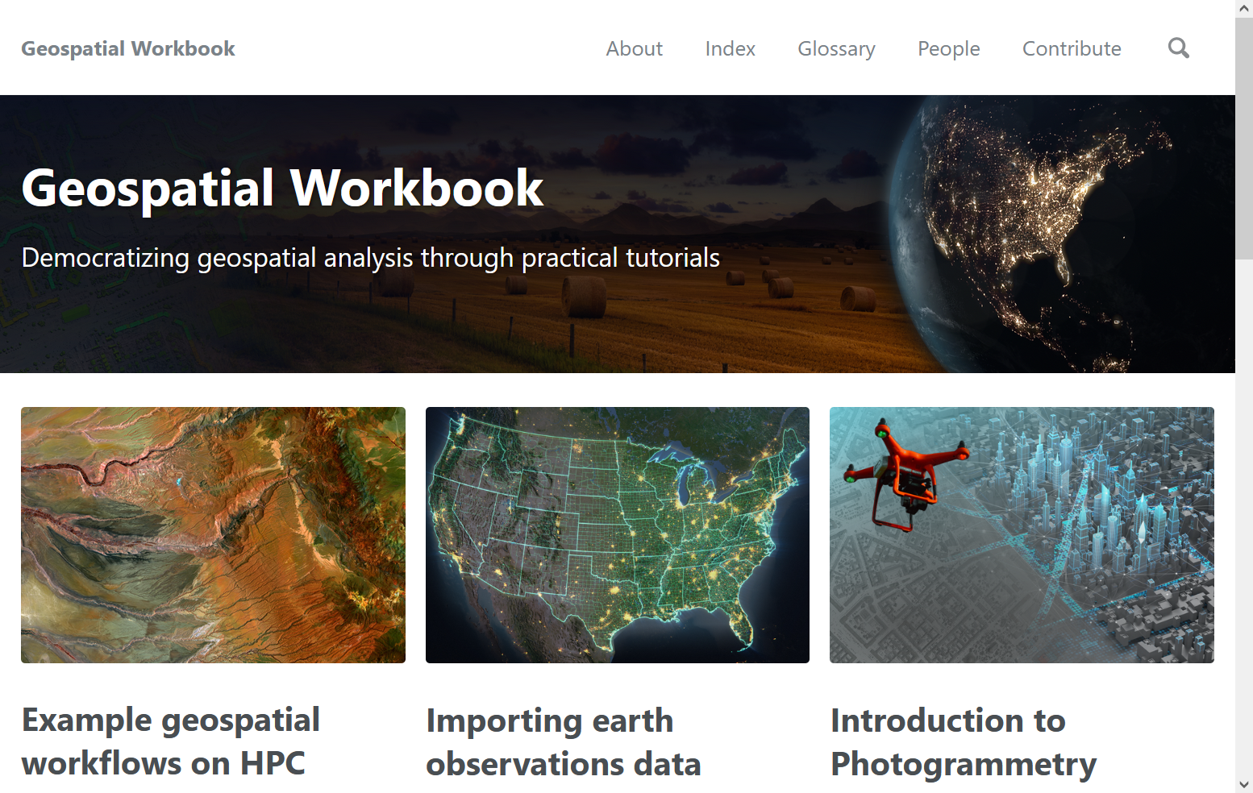
Training and education
Online tutorials and guides
https://scinet.usda.gov/training/workbooks
Notes:
The geospatial workbook provides tutorials on drone image processing workflow guides, image analysis techniques, using R and Python for geospatial tasks, and more.
Right: partial screenshot of the "Making publication-quality maps in R" tutorial. Tutorials are a mix of explanatory text, code chunks, and output including figures.
We welcome ideas for new content and volunteers to contribute content.

Slide 17


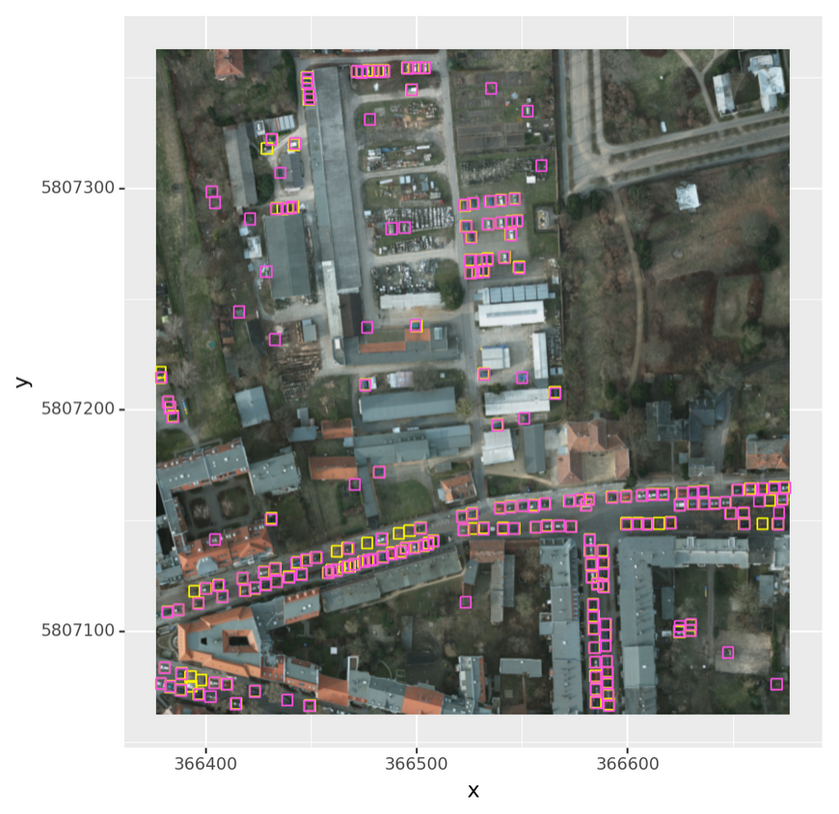
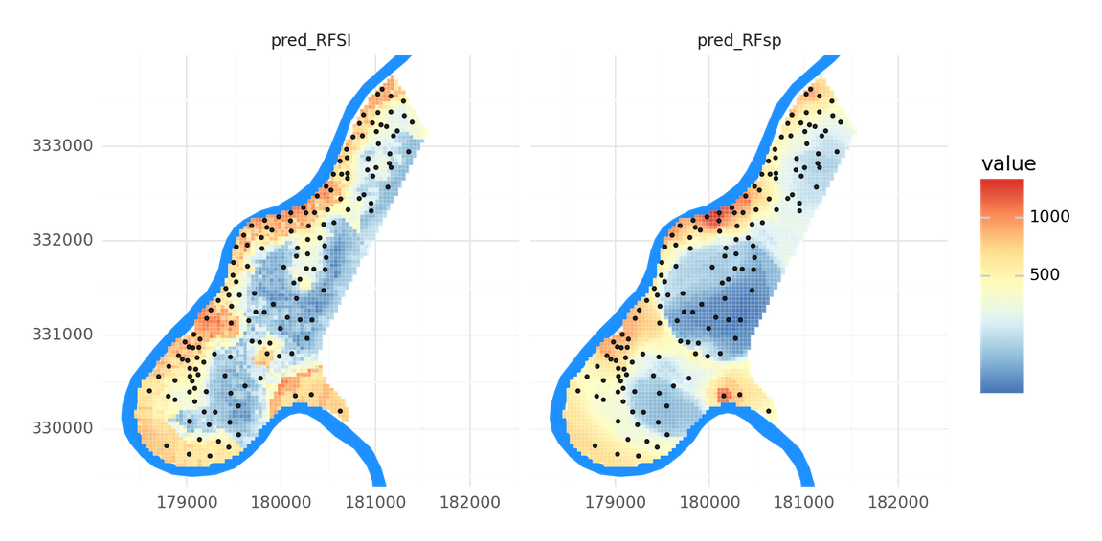
Training and education
Online tutorials and guides
Training workshops
Spatial interpolation with machine learning
Deep learning for aerial imagery
Notes:
Past SCINet workshops have included geospatial-focused tutorials:
Geospatial data processing workflows in R and Python, many of which are mirrored in the Geospatial Workbook. For example:
Comparing geostatistical and machine learning methods for spatial interpolation from point observations
How to use Deep Learning libraries in Python for geospatial rasters (RasterVision)

Slide 18

Training and education
Online tutorials and guides
Training workshops
Longer courses
Notes:
Coursera licenses are available to SCINet users. Coursera library of courses includes a multiple of course topics, including geospatial topics.

Slide 19
Training and education
GRWG
Online tutorials and guides
Training workshops
Longer courses
Geospatial Research Working Group
Notes:
The WG dictates the development of the GeoCDL, Geospatial Workbook, and workshop development.
We have quarterly meetings for general status updates and new ideas, bimonthly GeoCDL meetings, and a big multi-day workshop typically in the fall.

Slide 20
https://scinet.usda.gov/
Questions?

